Slide 1
Curve Fitting for Polynomial Functions
ISTA 331 Lab 6
Spring 2020

Slide 2
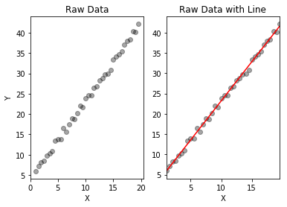
Review: Curve Fitting a Linear Function
We can fit a linear curve to some data with the help of statsmodels
With the OLS class in statsmodels.api, it is possible to create linear models from which we can see how they fit to our data
The process usually involves passing our data to OLS, getting the model parameters, and generating a dataset with the model parameters to understand how it compares to the original data
An example of making a line of best fit (in red) and comparing it to the original data

Slide 3
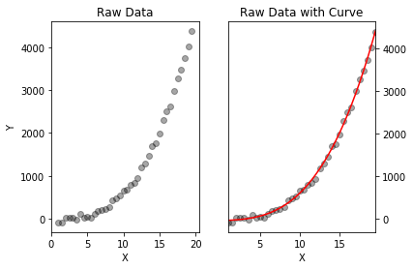
Fitting Polynomials
But, not all functions are linear
So how do we model polynomial functions? → (Almost) the same way!
To fit a linear polynomial function, we can still use use OLS and statsmodels
Before we add the constant column and call OLS, we first need to call column_stack from numpy in order to generate enough features for OLS
An example of making a cubic curve of best fit (in red) and comparing it to the original data

Slide 4
Why is Column Stacking Important?
numpy.column_stack(), in general, takes several arrays and “stacks” them as columns into a 2-D array for us
Most of the time, we have our data stored in a Series. Column_stack will allow us to take our x (the index) and turn it into x, x², x³, etc.
One way to think about this is taking a Series, adding more features to it, and turning it into a DataFrame (or, a 1-D array to a 2-D array with more columns)
Ultimately, this tells OLS that we want to fit something other than a linear function. Namely, we want to fit whatever we stacked up to!

Slide 5
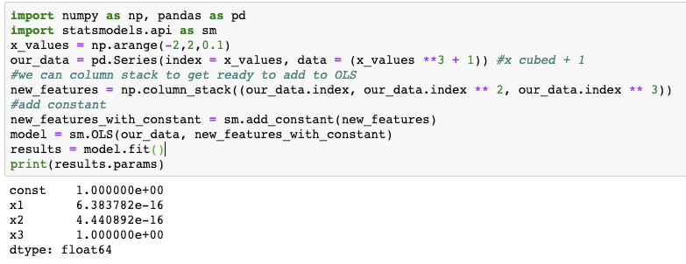
Example of Fitting a Polynomial Function
Other than the model parameters, there are multiple other reported statistics. Two of the most important are R² and Mean Square Error

Slide 6
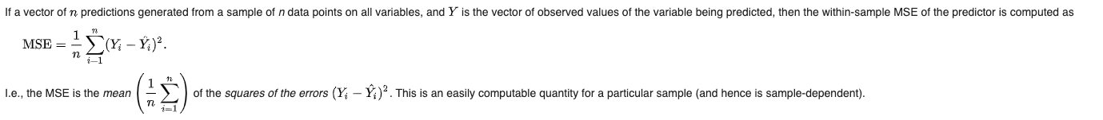
Mean Square Error
Mean Square Error is one metric used to identify a model’s goodness of fit to some data
This is literally a measure of how close (or far) a model is from the points it is trying to fit
Generally, the mean square error is the total square sum of each data point from what the model predicts it should be.
OLS finds the parameters that minimize the mean square error for the data!
From Wikipedia:

Slide 7
R²
R², often called the coefficient of determination, is one way to measure the goodness of fit of a model
Technically ranges from - ∞ → 1 (negative infinity to 1), but mostly falls between 0 and 1
In linear regression, R² is literally the correlation squared
Simply put, it involves a ratio between the total sum of squares of the data itself and the sum of the data’s square residuals
The total sum of squares is related to the variance of the data. It is the sum of the square difference between each data point and the arithmetic mean of the dataset.
The sum of square residuals of the data is the square difference between each data point and what the model predicted it should have been
In the end, R² = 1 - (sum of square residuals / total sum of squares)

Slide 8
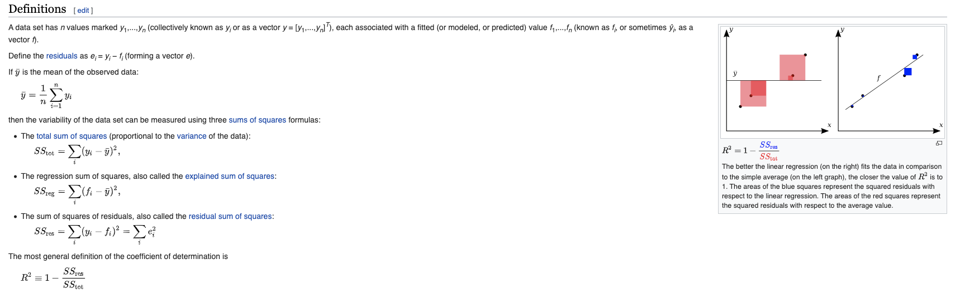
R² from Wikipedia…
https://en.wikipedia.org/wiki/Coefficient_of_determination

Slide 9
Possible Workflow for Fitting Polynomial Curves to Data
Import numpy, pandas, statsmodels.api, and matplotlib.pyplot
Read in/clean data. Put into a Series
Column stack the index to turn it into the proper number of features
Take the column stacked features and the original Series, pass to OLS to get a model
Fit the model to the data
Return the parameters and other necessary data such as the root mean square error, f-value or the R²
Prepare any visuals of the original data and the model’s prediction

Slide 10
Summary
To fit nonlinear polynomial functions to data, we have to slightly change our process from linear fitting → use np.column_stack
Column stacking gives us the proper number of features to pass into OLS to make our model
OLS finds the parameters for the model that has the lowest mean square error
While model parameters are important, the coefficient of determination, R², is one of the best available metrics for goodness of fit of the model to our data.

